Slide 1


Segmentation of Overlapping Cervical Cells by Joint Level Set Method
ECE 435 Medical Image Processing
Brian Pattie, Yiping Wang
2019.4.1

Slide 2
Outline
Introduction
Algorithm Pipeline
Qualitative and Quantitative Results
Conclusion

Slide 3
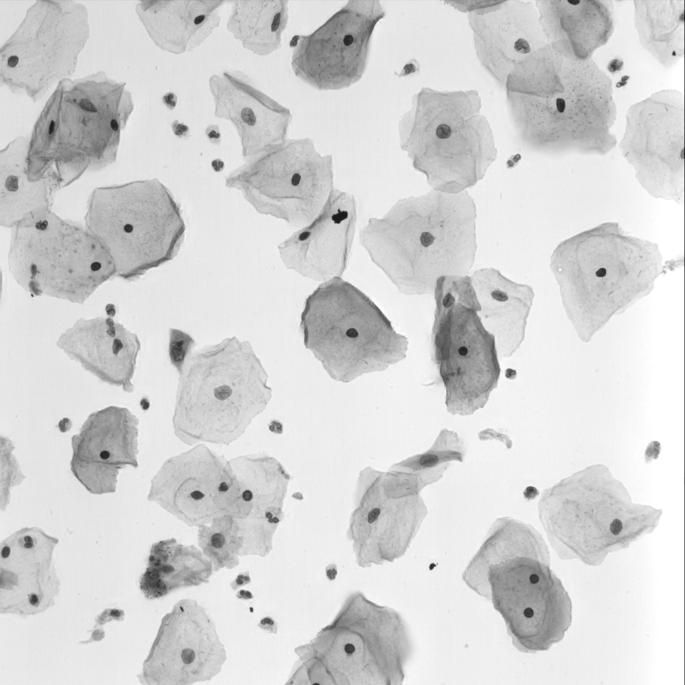
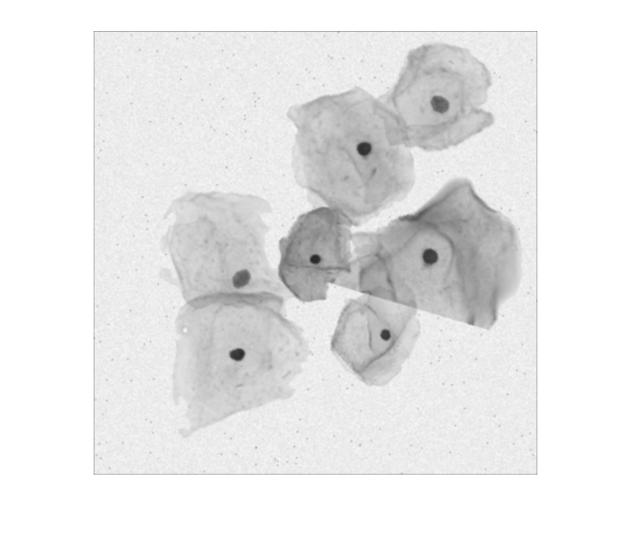
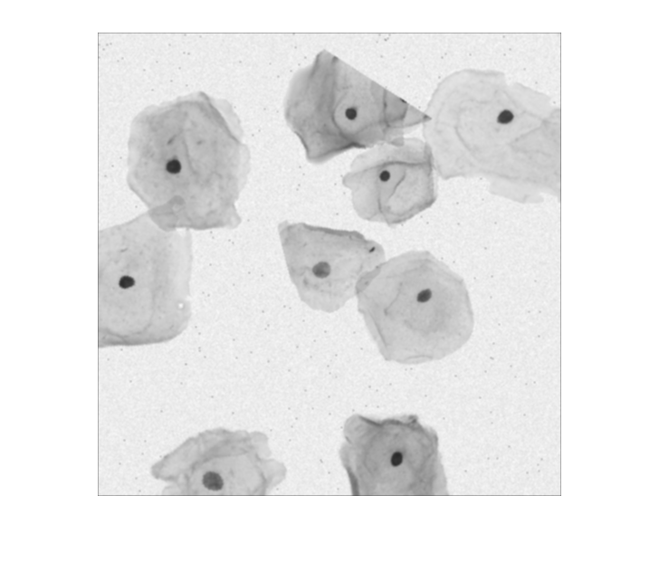
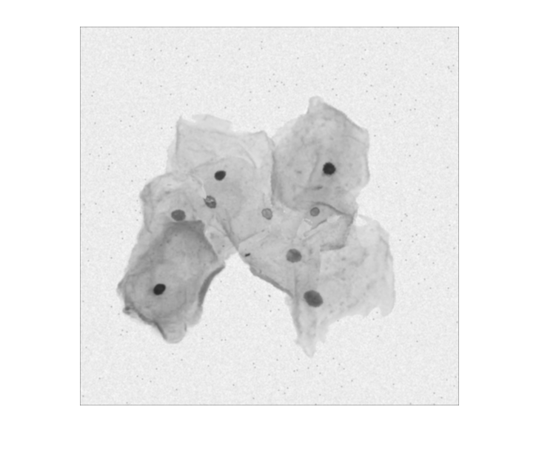
Introduction
Automated Nucleus and Cytoplasm Segmentation of Overlapping Cervical Cells Authors: Zhi Lu, Gustavo Carneiro, and Andrew P. Bradley Publication: MICCAI 2013
ISBI 2014 Dataset Featuring:
16 EDF real cervical cytology images
945 Synthetic images
Figure 1: Sample Synthetic Images from ISBI 2014 Training Dataset
Figure 2: Sample Real Image (EDF000) from ISBI 2014 Dataset

Slide 4
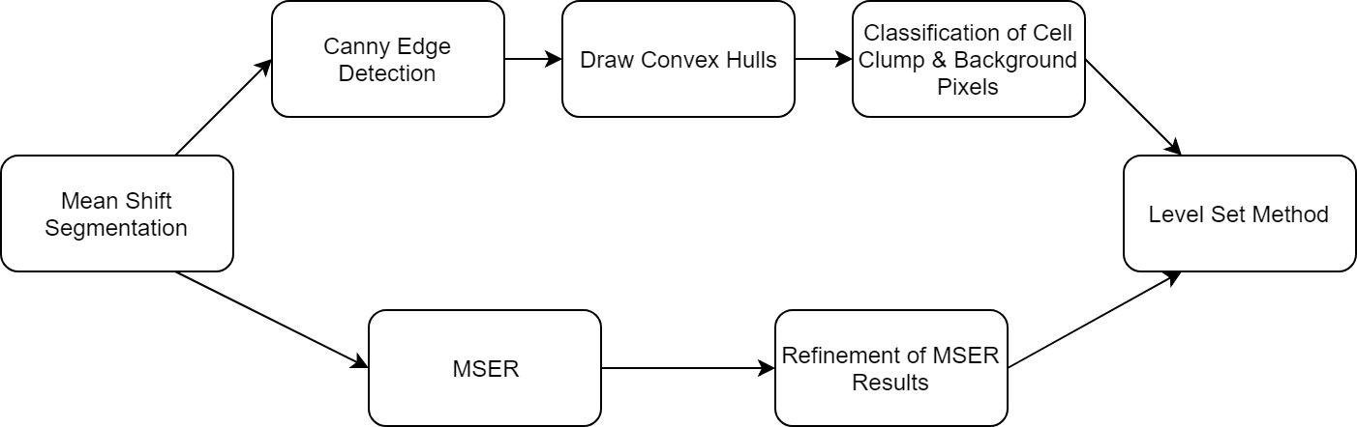
Algorithm Overview
Figure 3: Overview of the cervical cell segmentation algorithm

Slide 5
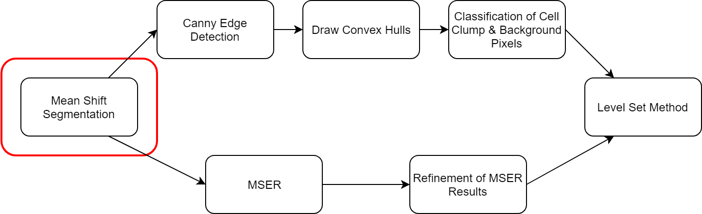
Mean Shift Segmentation
Figure 4: Overview of the cervical cell segmentation algorithm

Slide 6
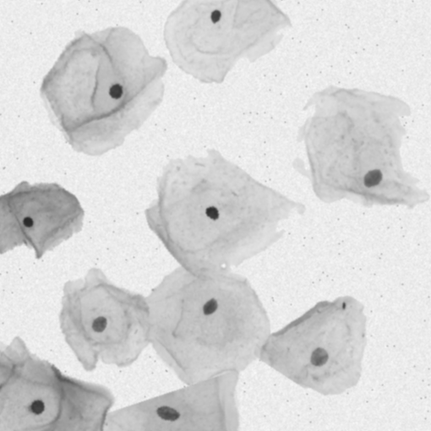

Mean Shift Segmentation
Figure 5: Synthetic Image 41 from ISBI 2014 Training Dataset
Figure 6: Result of Mean Shift Segmentation on Figure 5

Slide 7
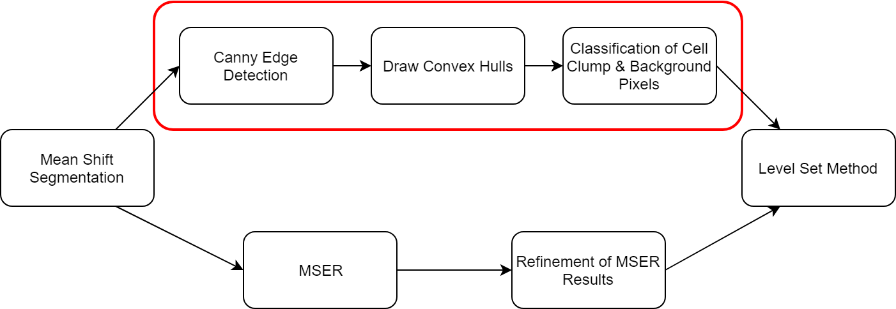
Cell Clump Segmentation
Figure 7: Overview of the cervical cell segmentation algorithm

Slide 8
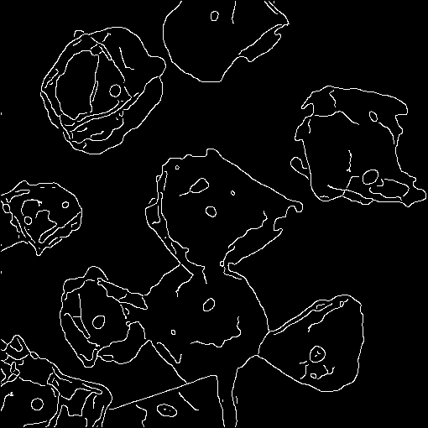
Canny Edge Detection
Figure 8: Mean Shift Segmentation of Synthetic Image 41
Figure 9: Result of Canny Edge Detection on Figure 8

Slide 9

Convex Hulls Around Connected Components
Figure 10: Result of Canny Edge Detection of Mean Shift Segmentation on Synthetic Image 41
Figure 11: Convex Hulls Around Connected Components on Figure 10

Slide 10

Convex Hulls – Second Iteration
Figure 12: Result of Canny Edge Detection of Mean Shift Segmentation on Synthetic Image 41
Figure 13: The Second Iteration of Convex Hulls on Figure 12

Slide 11

Classification: Initial Pixel Assignment (Masks)
Figure 14: Convex Hull image from previous slide. Pixels from the white regions will be assigned as “Cell Clump” for training the linear regression model.
Figure 15: Flipped binary image of Figure 14. Pixels from the white regions will be assigned as “Background” for training the linear regression model.

Slide 12
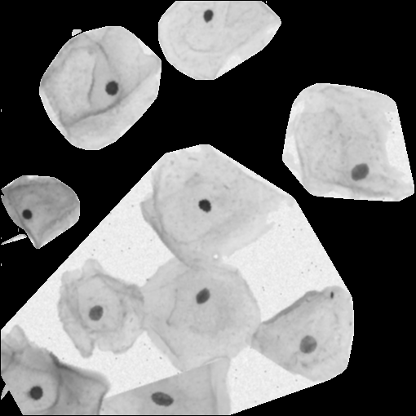
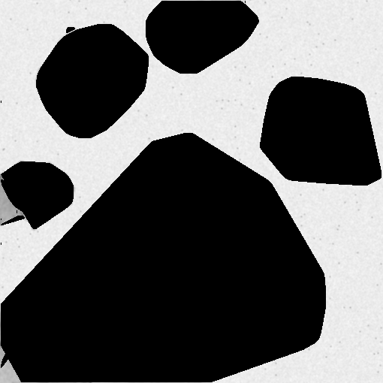
Classification: Linear Regression Model Training
Figure 16: Convex Hull image from Figure 14 with Original Image Pixels Overlayed.
Figure 17: Inverted Convex Hull image from Figure 16 with original image pixels overlayed.

Slide 13


Classification: Linear Regression Predictions
Figure 18: Output of linear regression model. White pixels are classified as “Cell Clump”.
Figure 19: Output of linear regression model. White pixels are classified as “Background”.

Slide 14
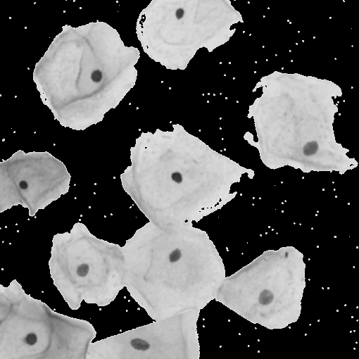

Classification: Cell Clump Segmentation
Figure 20: Linear Regression “Cell Clump” Segmentation of the Original Image.
Figure 21: Linear Regression “Background” Segmentation of the Original Image.

Slide 15
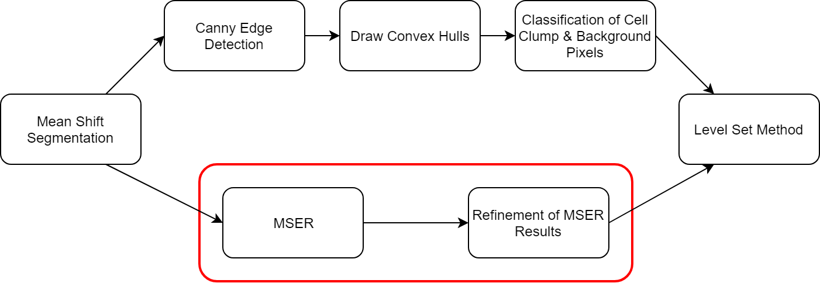
Nuclei Segmentation
Figure 22: Overview of the cervical cell segmentation algorithm

Slide 16
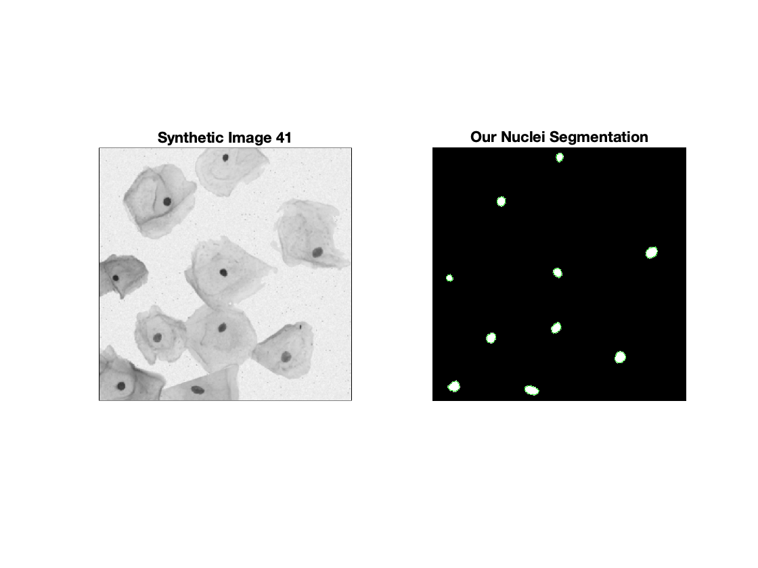
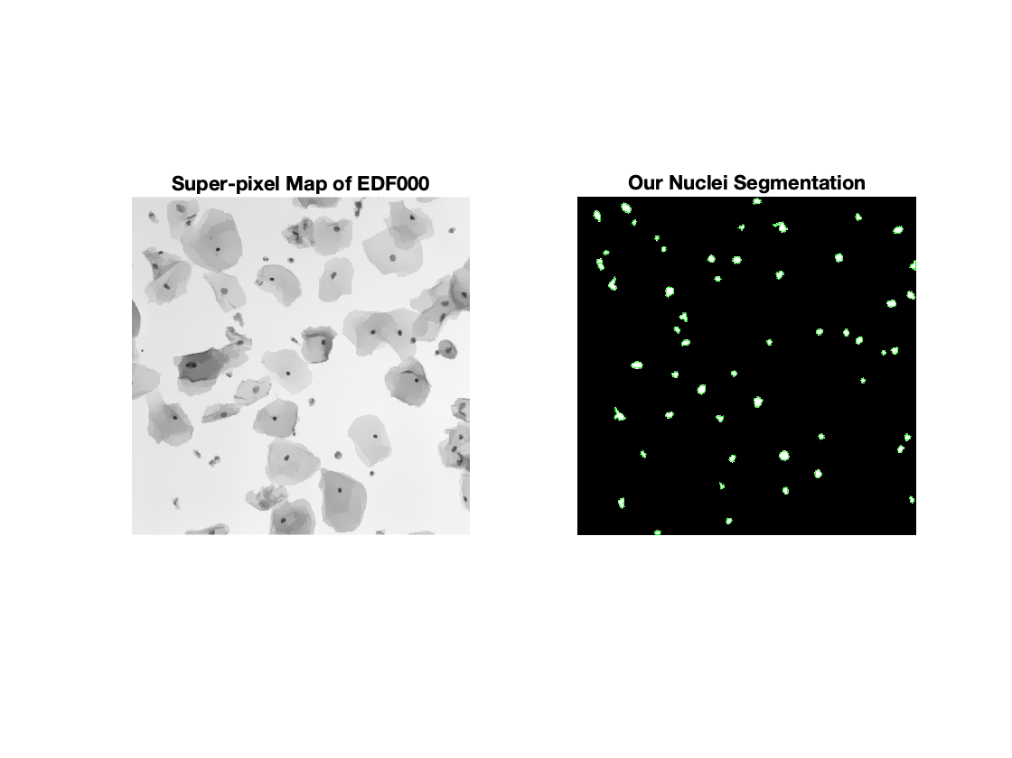
Nuclei Segmentation
Figure 23: Our Nuclei Segmentation of Synthetic Image 41
Figure 24: Our Nuclei Segmentation of Super-pixel Map of EDF000

Slide 17
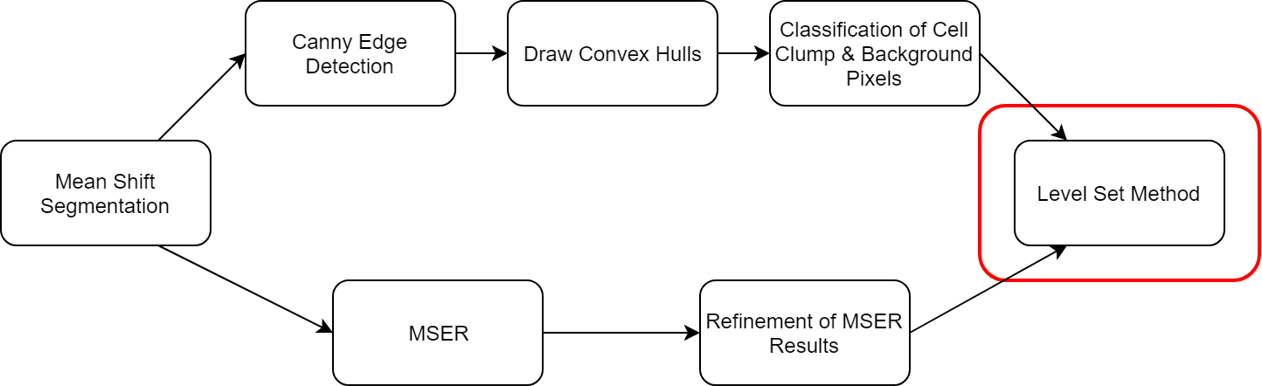
Final Segmentation via Level Set Method
Figure 25: Overview of the cervical cell segmentation algorithm

Slide 18
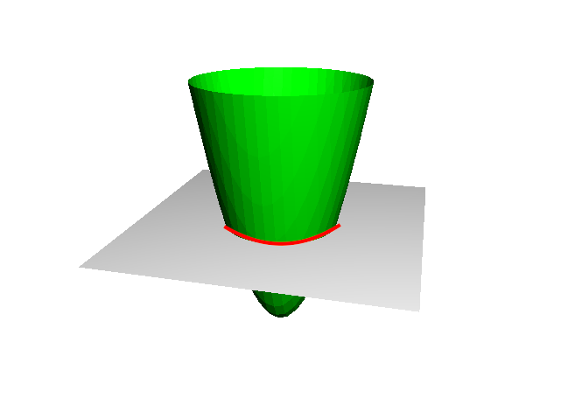
Basics of the Level Set Method
2D contour is represented by a 3D shape called a Level Set Function (LSF)
The contour is represented by the Zero Level Set, where the height of the LSF is 0
An Energy Function (or Force Function) adjusts the shape of the LSF, and by extension, the shape of the contour
Negative values in the LSF represent points inside the contour, and positive values represent points outside
Figure 26: Level Set Function (green) intersecting the image plane (gray) at the Zero Level Set (red).

Slide 19
Example: Level Set Function Definition
In the example LSF to the right, the red line represents the contour
So long as the Zero Level Set lies on the contour, and the sign properties are maintained, the meaning of the magnitude is up to the developer
Our magnitudes represent the distance to the contour
1.4 | 1 | -1 | -1 | -1 | 1
1 | -1 | -1.4 | -2 | -1 | 1
1 | -1 | -2 | -1.4 | -1 | 1
1 | -1 | -1 | -1 | 1 | 1.4
1.4 | 1 | 1 | 1 | 1.4 | 2.2
2.2 | 2 | 2 | 2 | 2.2 | 2.8
Figure 27: Level Set Function in matrix form. Red line indicates the contour (or Zero Level Set)

Slide 20
Example: Energy Function
The energy function is also represented as a matrix
In our algorithm, only pixels along the contour are considered in each evolution
The matrix to the right shows a potential Energy Function
The values in the Energy Function are derived from properties of the image
-0.4 | -0.8 | -2 | -2 | -2 | -0.8
-0.8 | -2 | -2 | 0 | -2 | -0.8
-0.8 | -2 | 0 | -2 | -2 | -0.8
-0.8 | -2 | -2 | -2 | -1.5 | -0.4
-0.4 | -1.5 | -1.5 | -0.8 | -0.4 | 0
0 | 0 | 0 | 0 | 0 | 0
Figure 28: Energy Function in matrix form. Red line represents the contour (or Zero Level Set)

Slide 21
Example: Applying the Energy Function to the LSF
1.4 | 1 | -1 | -1 | -1 | 1
1 | -1 | -1.4 | -2 | -1 | 1
1 | -1 | -2 | -1.4 | -1 | 1
1 | -1 | -1 | -1 | 1 | 1.4
1.4 | 1 | 1 | 1 | 1.4 | 2.2
2.2 | 2 | 2 | 2 | 2.2 | 2.8
-0.4 | -0.8 | -2 | -2 | -2 | -0.8
-0.8 | -2 | -2 | 0 | -2 | -0.8
-0.8 | -2 | 0 | -2 | -2 | -0.8
-0.8 | -2 | -2 | -2 | -1.5 | -0.4
-0.4 | -1.5 | -1.5 | -0.8 | -0.4 | 0
0 | 0 | 0 | 0 | 0 | 0
Figure 29: Summation of Level Set Function with Energy Function. Red line represents the contour (or Zero Level Set)

Slide 22
Example: Resulting LSF
Any pixels that become negative are moved inside of the contour
However, the distance property no longer holds
1 | 0.2 | -3 | -3 | -3 | 0.2
0.2 | -3 | -3.4 | -2 | -3 | 0.2
0.2 | -2 | -2 | -3.4 | -3 | 0.2
0.2 | -3 | -3 | -3 | -0.5 | 1
1 | -0.5 | -0.5 | 0.2 | 1 | 2.2
2.2 | 2 | 2 | 2 | 2.2 | 2.8
Figure 30: Level Set Function resulting from the summation on the previous slide. Red line represents the new contour (or Zero Level Set)

Slide 23
Example: Re-initialized LSF
To compensate, the LSF is re-initialized after every evolution
Now all magnitudes represent distance to the contour
1.4 | 1 | -1 | -2 | -1 | 1
1 | -1 | -1.4 | -2 | -1 | 1
1 | -1 | -2 | -2 | -1 | 1
1 | -1 | -1.4 | -1 | -1 | 1
1 | -1 | -1 | 1 | 1 | 1.4
1.4 | 1 | 1 | 1.4 | 2 | 2.2
Figure 31: Re-initialized Level Set Function. Red line indicates the contour (or Zero Level Set)

Slide 24
The Energy Function: Unary Terms
The unary terms, A, L, and P, are independent of any other LSFs.
A, the area term, adds energy when the LSF’s area is below a minimum threshold, and removes energy when above a maximum threshold.
L, the length term, adds energy based on the gradient of the LSF. This term may not make sense with our implementation, and may be removed in the final version.
P, the shape prior term, adds energy to pixels closer to the center of the LSF, encouraging a circular shape.

Slide 25
The Energy Function: Binary Terms
The binary terms, V and N, are calculated using the overlap between the current LSF and any other LSFs in the same cell clump.
V, the overlapping area term, removes energy from pixels that would overlap another LSF. The energy removed is proportional to the size of the overlapping area.
N, the overlapping intensity term, removes energy from pixels in the overlap proportional to the difference in mean intensity between the inside of the LSF and the region of of overlap. Darker intensities indicate more overlapping cells.

Slide 26
The Energy Function: Constants
α, λ, ρ, ζ, ω are constant weighting terms defined before run time.
G is an edge weight matrix derived from the original image. Values range from 0 to 1, with lower values indicating stronger edges.
C is an arbitrarily large constant value applied to all pixels outside of the cell clump mask. This prevents the LSF from expanding into the background pixels

Slide 27
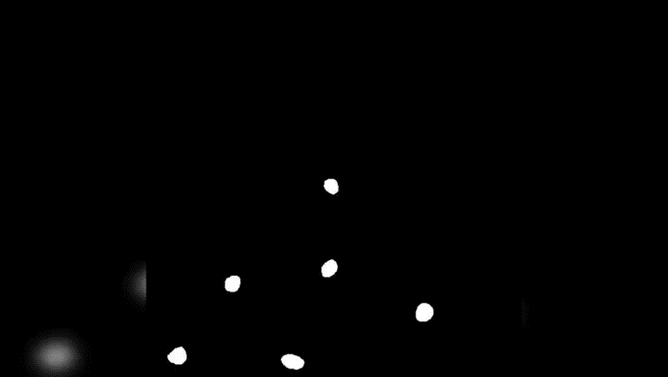
LSF Evolution: 150 iterations
Video Demo 1: Level Set Function Evolution
Video Source on YouTube

Slide 28
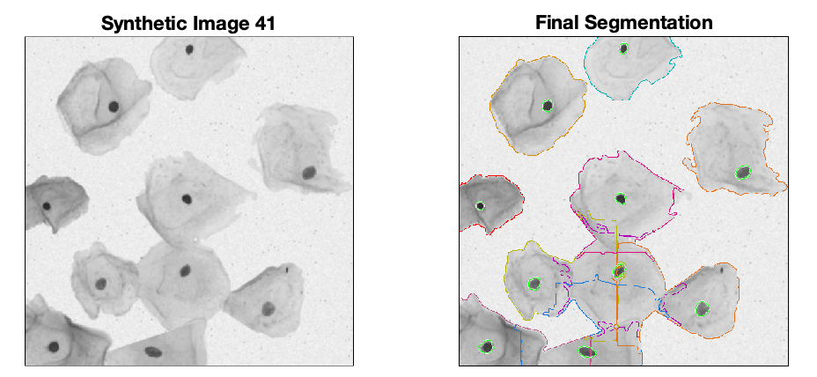
Joint Level Set Method Result on Synthetic Image
Figure 32 : Synthetic Image 41 and the Final Segmentation Result of Our Segmentation Algorithm Pipeline

Slide 29
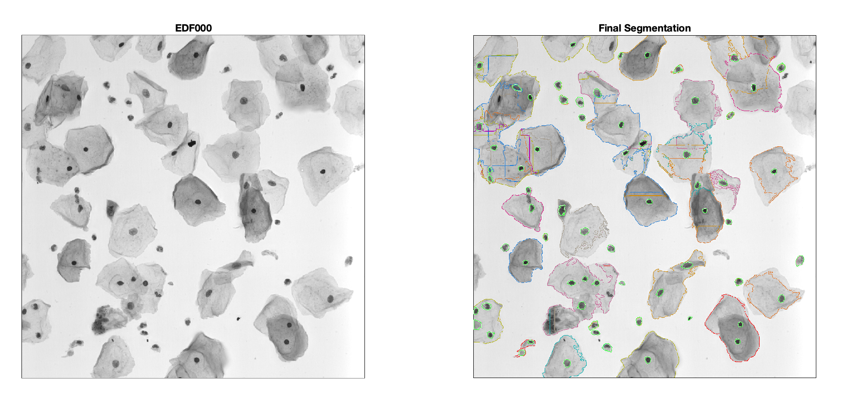
Joint Level Set Method Result on Real Image
Figure 33 : Real Image EDF000 and the Final Segmentation Result of Our Segmentation Algorithm Pipeline

Slide 30
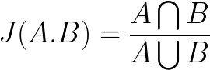
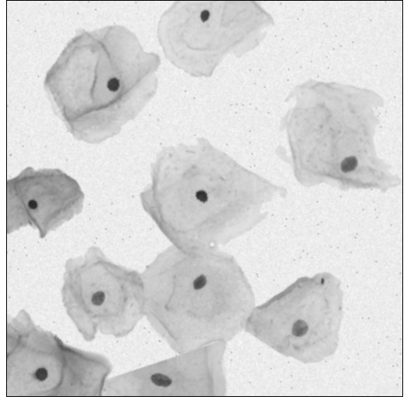
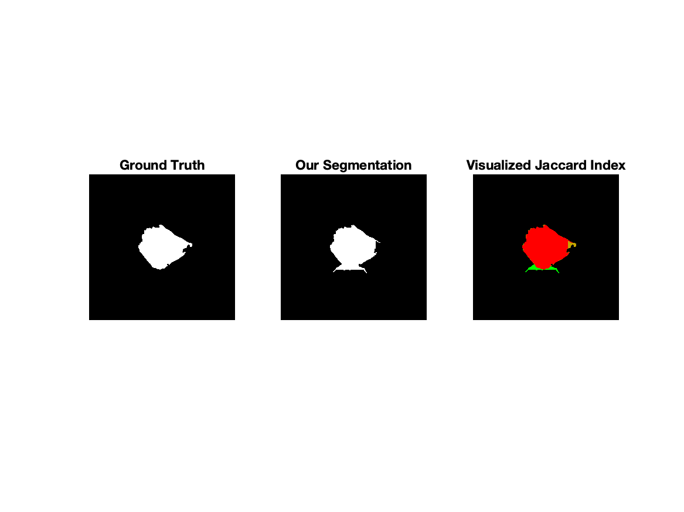
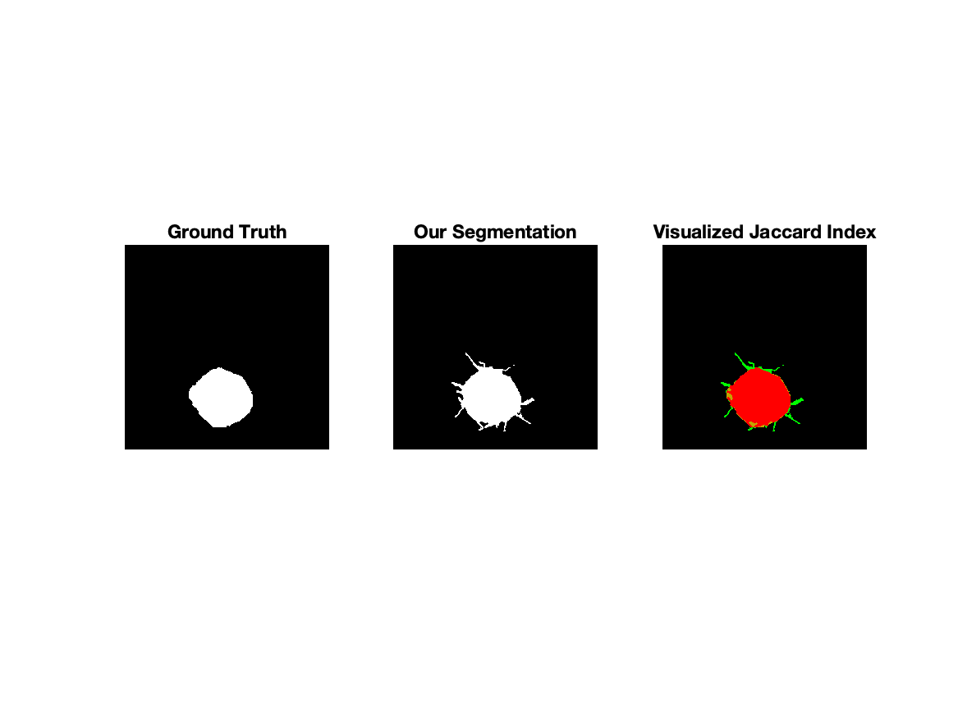
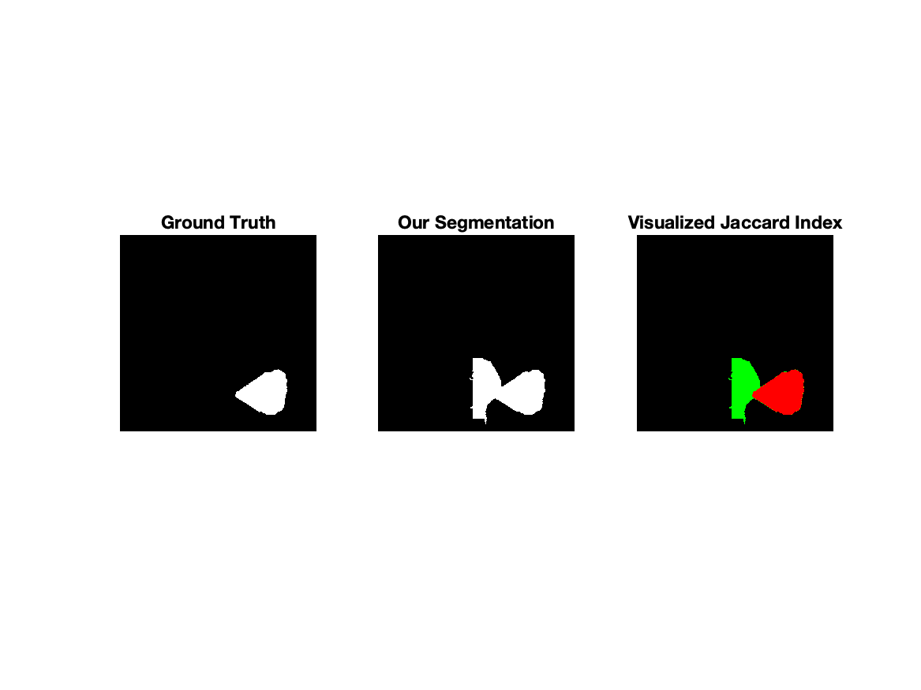
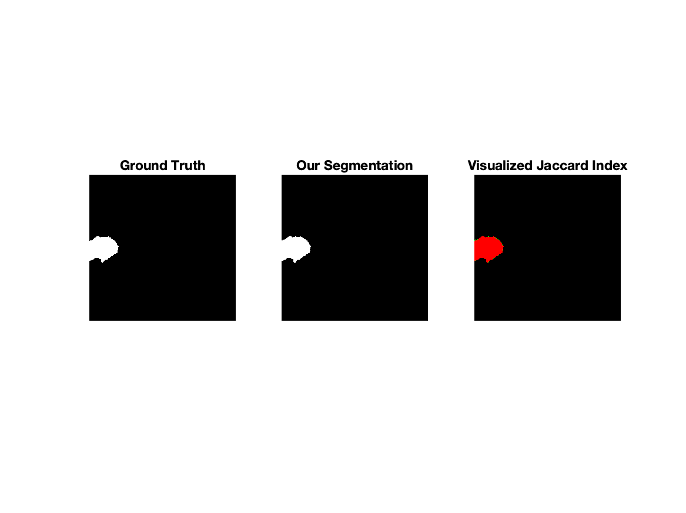
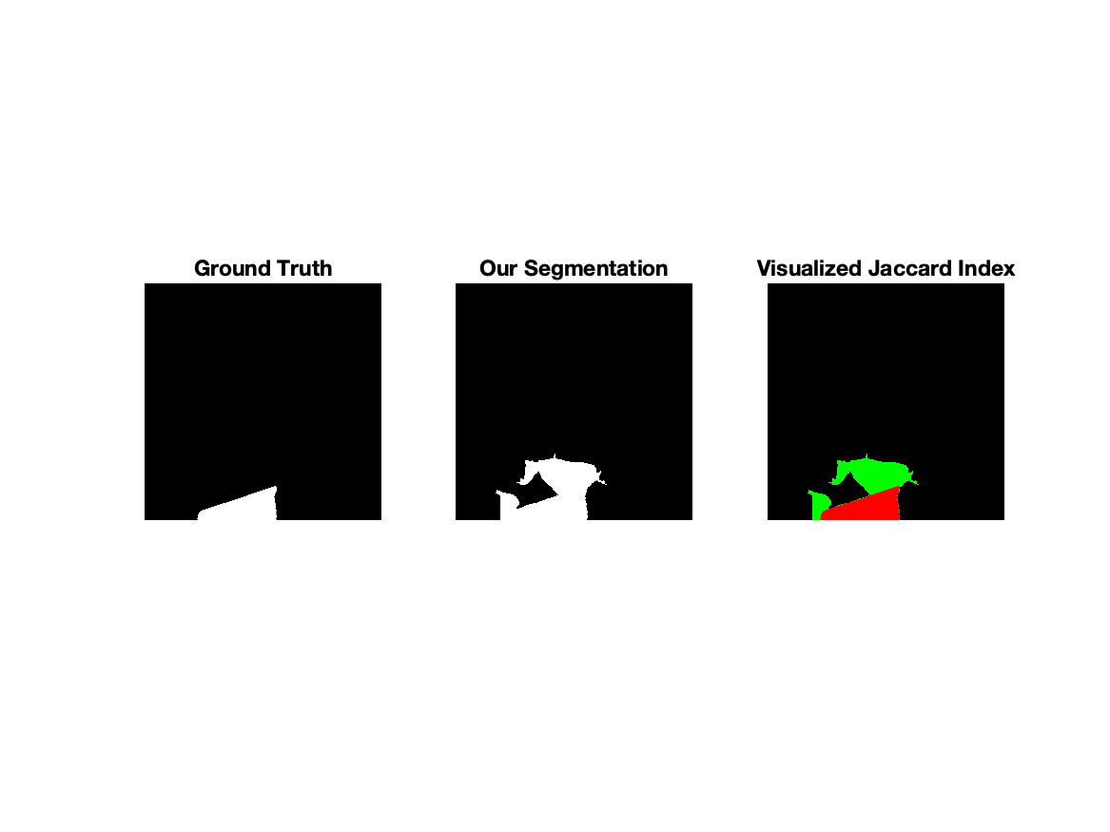
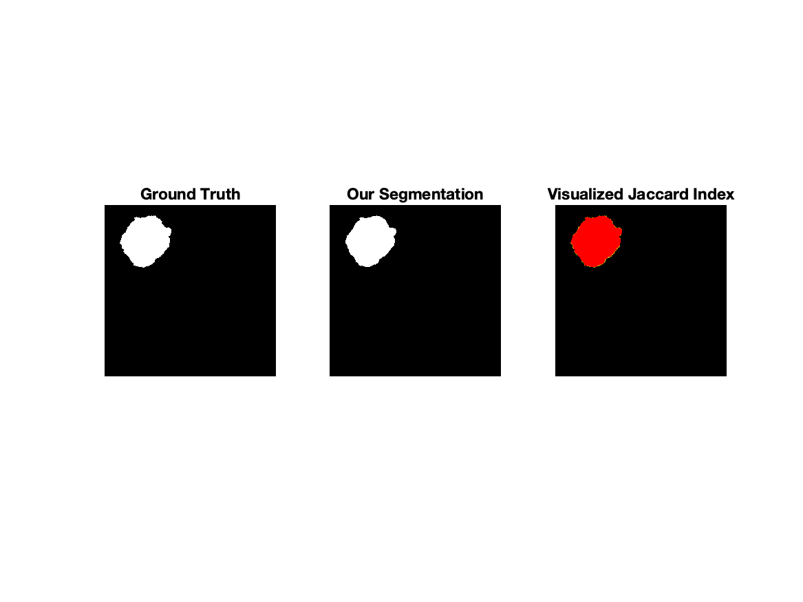
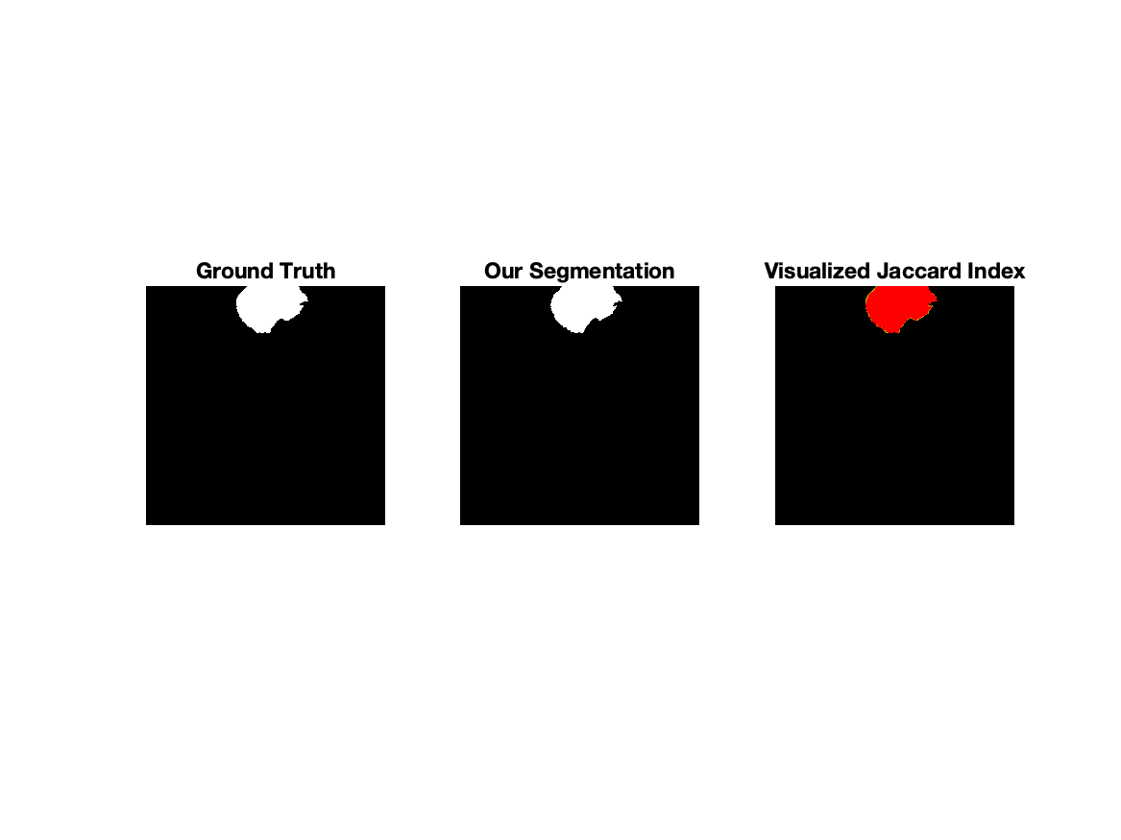
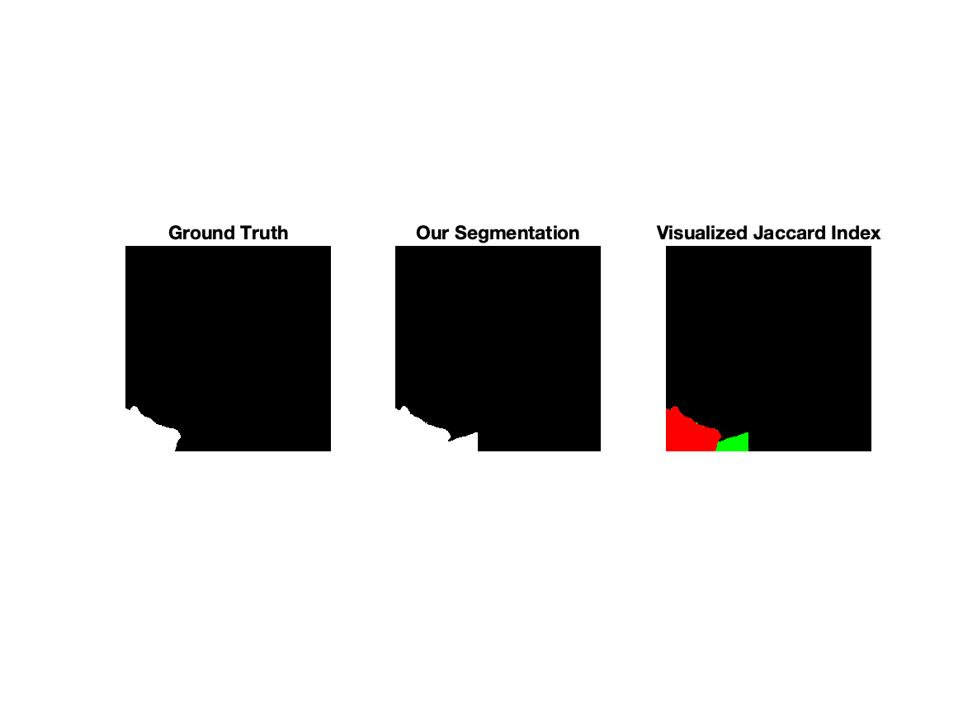
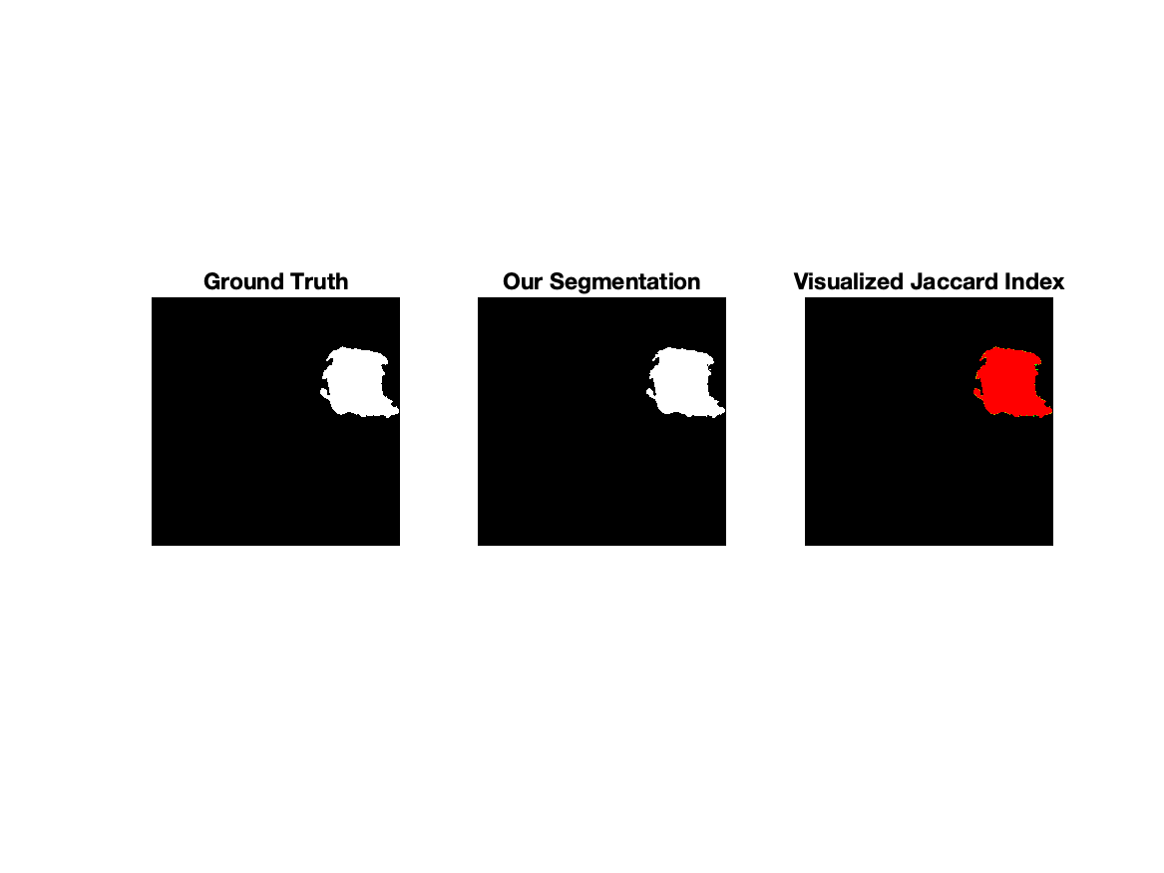
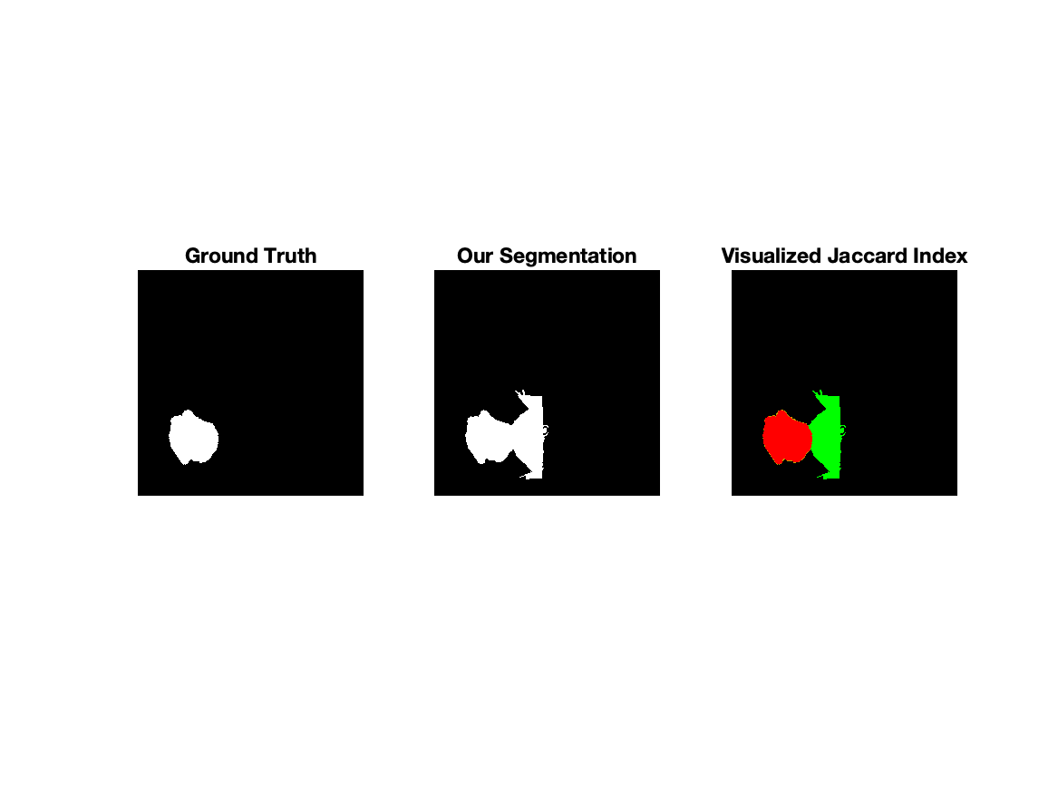
Quantitative Results
Red: Overlap Area
Green: Segmentation Area
Yellow: Ground Truth Area
Measure region similarity: Jaccard Index
Figure x: Synthetic Image 41 from ISBI 2014 Dataset as Input
Video Demo 2: Visualization of Jaccard Index
Average Jaccard Index on Each Cell (10 Cells in Total): 0.7890

Slide 31
Qualitative Results
Segmentation creates good divisions between cell clumps and background, but poor division between overlapping cells. Our Jaccard Index is inflated by good results on single cell clumps.
Pixel Classification misclassifies some cell clump pixels as background, and vice versa.
Nuclei Segmentation misclassifies some noisy objects as nuclei in real cell images.

Slide 32
Potential Improvements
Tune the weighting parameters in Level Set Evolution algorithm
Area Term is too strong; It dominates all other terms.
Overlapping Area and Intensity terms are too weak; They fail to prevent the Level Set Function from expanding into neighbouring cells.
Replace shape prior term with one that promotes an elliptical shape
Current term promotes circular shape
Replace the naive mean shift algorithm
Currently closer to a bilateral filter than a mean shift
Requires several iterations and many Euclidean distance calculations

Slide 33
Conclusion
Our algorithm is effective for segmenting individual cells, but fails to accurately deduce boundaries of overlapping cells.
Fine-tuning the hyper-parameters is necessary to improve performance on overlapping cells.

Slide 34
Q & A

